Slide 1
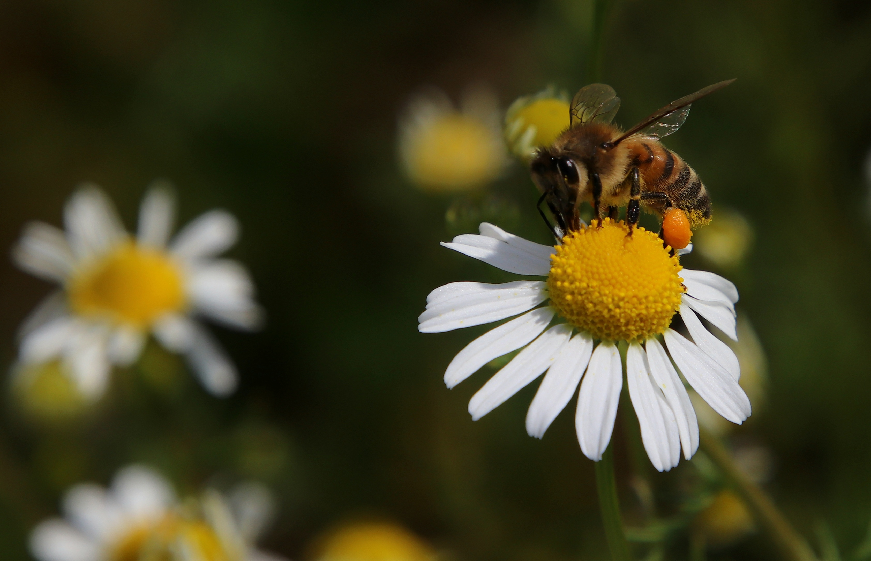
1st PRIZE
in the EUROPEAN SCHOOL
“SPRING IN LUXEMBOURG 2025” PHOTOGRAPHY CONTEST is awarded to
A very good illustration of spring. This photo is well composed, balanced, and technically very hard to take. Congratulations!
In collaboration with Photo Club CIEL

